Slide 1


https://www.jiujitsutimes.com/goal-setting-for-2015/

Slide 2
Features vs Benefits
Feature- a fact about the product or service being promoted.
This is not what entices customers to buy.
Benefit answers the question "What's in it for me?,“
Tell the customer what benefit they will gain from having the feature
http://owners.honda.com/vehicles/information/2017/Odyssey

Slide 3


Can You Sell?
Galaxy S6 Edge+

Slide 4

Career Action Plan
What is your ultimate career goal?
https://www.youtube.com/watch?v=2H6uJT16FtE

Slide 5
Action Plan
An effective action plan should give you a concrete timetable and a set of clearly defined steps to help you achieve your objective.
Helps you focus your ideas and provides you with an answer to “what do I do to achieve my objective?”
Where am I now?
Where do I want to be?
How do I get there?
Take action
Review the plan

Slide 6
Co-op Work Term Action Plan
End Point for Co-op Work Term
Goals & Objectives
Strategic Planning (Timeline)
Evaluation/Accountability

Slide 7
Identify your End Point (For co-op work term)
The most effective way to begin with the end in mind is to develop an End Point.
Develop an End Point(for your co-op work term), one that focuses what you want to be in terms of character and what you want to do in reference to contribution of achievements.
Stephen Covey

Slide 8
Set S.M.A.R.T. Goals
You build your future by developing concrete plans to reflect your priorities
These become your goals for the next year
It is important that you develop focused goals that are each of the following:
Specific
Measurable
Achievable
Realistic
Time Stamped
Notes:
8
Many people do not routinely set goals for themselves. In fact, most people report that they “FELL” into their jobs. Goals are like train rails. They keep us on tack. They allow us to stay focused while moving forward.

Slide 9
Specific
Goals need to be clearly stated so they are easily understood and easy to remember.
Define whether the goal is short term or a long term goal.
short term is immediate to one year
long term will be two to three years

Slide 10
Measurable
The only way to know whether you accomplished your goals is if you have some way to measure it.
Use numbers, if possible, to evaluate your progress.
i.e. I will send out 25 resumes within six months.

Slide 11
Achievable
Is your goal achievable in the allotted time
Impossible goals guarantees failure and low morale
What steps must you take in order to achieve your goal?

Slide 12
Realistic
Be realistic about how long it will take to reach your goal and the steps required to get there

Slide 13
Time Stamped
Without a defined deadline or time frame, it is too easy to procrastinate
Have a set time limit for each of your goals

Slide 14
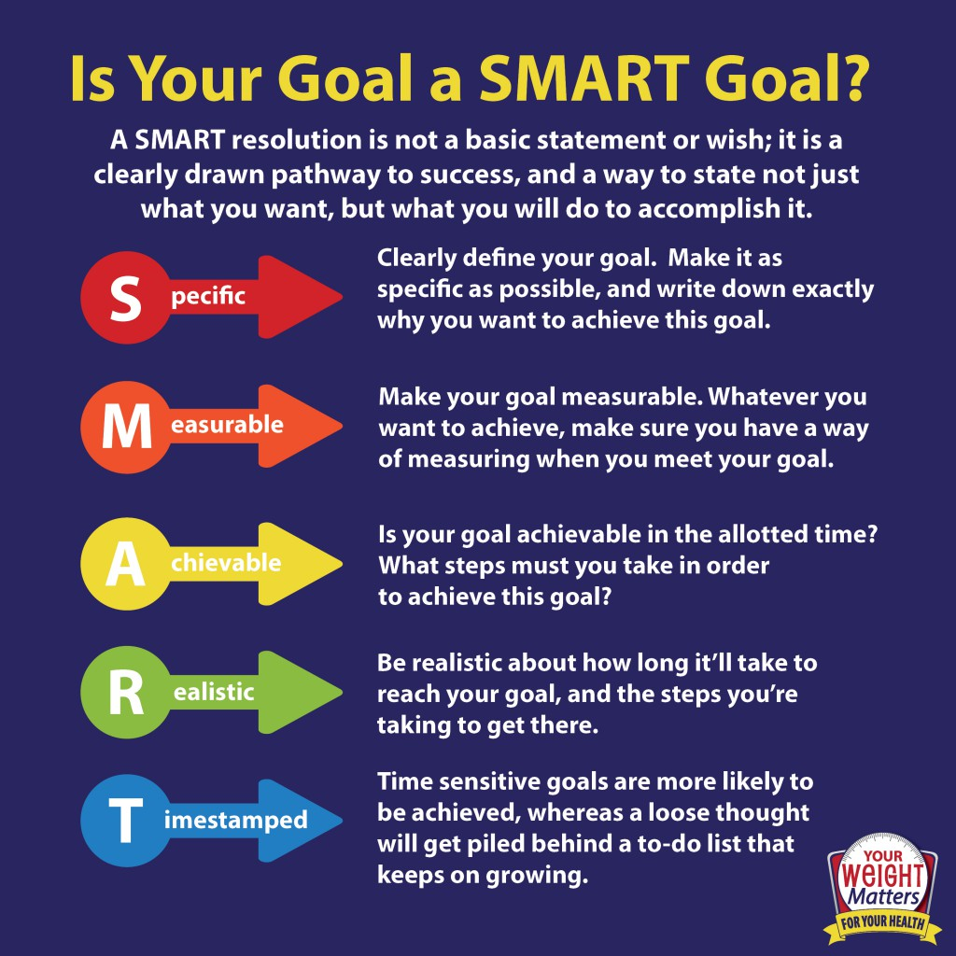
http://anaidza.com/what-is-a-smart-goal-acronym-smart-goals#forward

Slide 15
Achieving Your Goals
Make a Commitment
Keep Track of Your Progress
Break it Down
Get Help
Revisit and Revise
Keep Your Eye on the Prize
Be Consistent
Let Your Goals Grow
Focus on Positive Thinking
Celebrate Every Success

Slide 16
Strategic Planning
Outline strategic steps to achieve goals and objectives in logical sequence using a P.E.R.T.
Start with your ultimate End Point and work backwards (start with the end in mind)

Slide 17
Strategic Planning – TimeLine
Create from your timeline chart a critical path that you can reference
Establish timelines (weekly, monthly) for each item on your chart
Results, check-off results, reward yourself when one of your defined goals or objectives is reached

Slide 18
Create a Timeline
Where you are now
Goal 1
Goal 2
Goal 3
Mission Statement
Where am I now?
Where do I want to be?
How will I get there?

Slide 19
Implementation – follow-up
Present this completed document to someone who will be an accountability partner with you help you evaluate and attain your goals
On your finished document you will, determine what this accountability structure will look like and establish a timeline for the accountability follow ups (ie. Once a week, once a month, etc)
Have your accountability partner sign the bottom of that page indicating that he/she agrees to partner with you in helping you attain your future goals

Slide 20
Goal Setting Worksheet Assignment
Where are you now?
Ultimate End Point – Where do you want to be? (beginning of your co-op work term)
How will you get there?
Today Co-op Work Term

Slide 21
Week #2 - Online Work
Research - Why 3% of Harvard MBA grads made 10 times more than their classmates
Submit – Answer this: Why is goal setting important to a successful job search?
Watch - How to Find and Do Work You Love
https://www.youtube.com/watch?v=jpe-LKn-4gM

